Slide 1
Distributed Deadlocks

Slide 2
1. Introduction
Distributed deadlocks occur when transactions in a distributed system are blocked indefinitely due to cyclic dependencies across multiple servers. Unlike local deadlocks (confined to a single server), distributed deadlocks involve global wait-for graphs where nodes represent transactions and edges represent "waits-for" relationships. Detecting and resolving these deadlocks is critical to maintaining system availability.

Slide 3
2. Global Wait-For Graph
A wait-for graph (WFG) captures dependencies between transactions. In distributed systems, this graph spans multiple servers, making detection challenging. A deadlock exists if there is a cycle in the graph.

Slide 4
2. Global Wait-For Graph
Example (Figure 17.12):
T → U → V → T
T waits for U, which waits for V, which waits for T.
This cycle indicates a deadlock.

Slide 5
3. Distributed Deadlock Detection
Two approaches are used to detect distributed deadlocks:
a. Centralized Detection
  A single global deadlock detector collects local wait-for graphs from all servers (Figure 17.14).
  Drawbacks: Poor scalability, single point of failure, and potential for phantom deadlocks (false cycles due to outdated information).

Slide 6
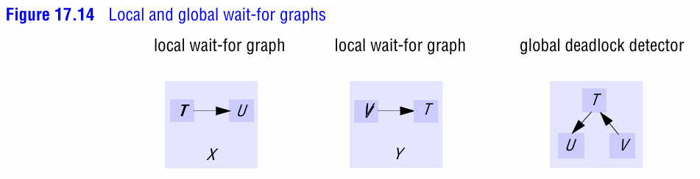

Slide 7
3. Distributed Deadlock Detection
b. Edge-Chasing (Path-Pushing) Algorithm
A decentralized method where probes (messages) traverse the network to detect cycles.
Steps (Figure 17.15):
Initiation: When a server detects a transaction T waiting for U (held by another server), it sends a probe <T → U>.
Detection: Probes are forwarded through servers, appending each new "waits-for" edge.
  Example: If U waits for V, the probe becomes <T → U → V>.
Resolution: If a probe returns to its origin (e.g., <T → U → V → T>), a deadlock is detected. One transaction in the cycle is aborted (typically the lowest-priority transaction).

Slide 8
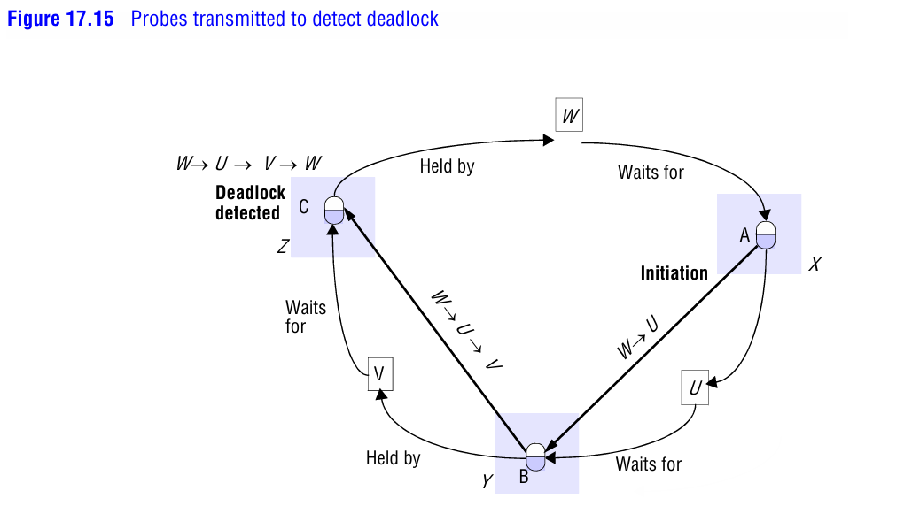

Slide 9
4. Phantom Deadlocks
A phantom deadlock is a false cycle detected due to:
Delayed messages: Probes may include edges from transactions that already aborted.
Partial information: Servers might not have the latest wait-for data.

Slide 10
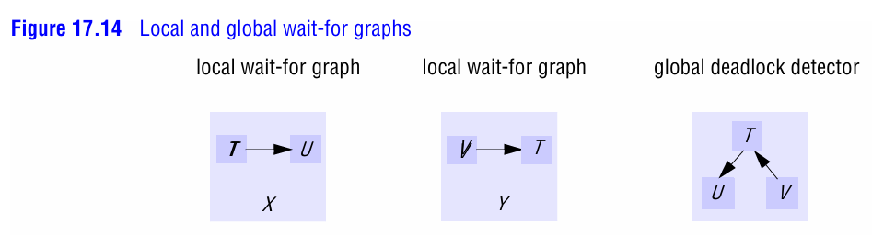

Slide 11
4. Phantom Deadlocks
Server X reports T → U, and Server Y reports U → V.
If U aborts after sending its vote, the detected cycle T → U → V → T is invalid.

Slide 12
5. Transaction Priorities
To resolve conflicts when multiple probes detect the same cycle:
Transactions are assigned globally unique priorities (e.g., timestamps).
The transaction with the lowest priority is aborted to break the cycle.
Example: If T > U > V > W, and cycle <T → U → W → V → T> is detected, W (lowest priority) is aborted.

Slide 13
6. Edge-Chasing Algorithm in Action
Probe Initiation:
Server X notices W waiting for U and sends probe <W → U>.
Probe Forwarding:
Server Y appends V (since U waits for V), creating <W → U → V>.
Server Z appends W (since V waits for W), forming <W → U → V → W>.
Cycle Detection:
Server Z detects the cycle and aborts W.

Slide 14
7. Challenges
Network Overhead: Probes generate message traffic (e.g., 2(N–1) messages for N transactions).
Uncertain State: Participants may wait indefinitely if the coordinator crashes.
False Positives: Phantom deadlocks require careful handling (e.g., timeouts, probe validation).

Slide 15
Summary
Distributed deadlocks involve cycles across servers, detected via global wait-for graphs.
Edge-chasing uses probes to detect cycles without centralized control.
Transaction priorities ensure consistent resolution decisions.
Phantom deadlocks are mitigated through strict locking and priority-based abort policies.

